Slide 1
TEASER: Early and Accurate Time Series Classification
Patrick Schäfer, Ulf Leser
Humboldt-Universität zu Berlin, Germany
Corresponding author: patrick.schaefer@hu-berlin.de
Journal Track at ECML / PKDD 2020, Belgium, 14.9.-18.9.
Notes:
My Name is Patrick Schäfer, I am working at the HU Berlin. I am presenting our framework for early and accurate time series classification called TEASER

Slide 2
Time series (TS) result from recording data over time
Increasingly popular due to growing importance of automatic sensors producing an increasing flood of large, high-resolution TS
It is assumed that all data is present at the time of classification
Often classification decisions are time-critical (e.g. prevent damage, diagnosis, predictive maintenance, reduce costs)
Early classification uses as few measurements as possible to make a safe (correct!) prediction
Correct/Safe prediction from here on?
Energy Consumption Trace
Notes:
Time Series result from recording data over time
Time Series data became increasingly popular due to the omnipresence of sensor’s recording large amounts of data
It is always assumed that we have all data present when doing classification
However, often classifications are time critical, e.g. to prevent damage to a machine, do medical diagnosis and determine the number of tests or to reduce the costs or loss in case of a stock market. Early classification tries to fill this gap, by producing a reliable / safe prediction seeing as few measurements as possible.
In case of energy consumption trace we ask, whether we have seen enough data to make a correct prediction.

Slide 3

prediction: y=Microwave
prediction: y=Receiver
prediction: y=Receiver
Slave classifiers make predictions on snapshots and produce confidences
When are these safe?
Confidences
Confidences
Confidences
1st slave classifier
2nd slave classifier
3rd slave classifier
Snapshot 1
Snapshot 2
Snapshot 3
Energy Consumption Trace
Notes:
It models eTSC as a two-tier classification problem
The input signal is divided into snapshots (here the energy consumption of a digital receiver)
A slave classifier periodically assesses the input snapshots and computes class probabilities.
When are these predictions safe?

Slide 4

y=Unsafe
y=Safe
y=Safe
1st master classifier
2nd master classifier
3rd master classifier
Master classifiers
learn from historic data, if slaves seeing this much data we correct
decide if a slave’s prediction is safe/unsafe
Confidences
Confidences
Confidences
1st slave classifier
2nd slave classifier
3rd slave classifier
Snapshot 1
Snapshot 2
Snapshot 3
Energy Consumption Trace
Notes:
a master classifier takes the class probabilities of the slave as input
It is always paired to a slave for a corresponding snapshot length
It learns from historic (training) data, if the slave’s predictions at these snapshot lengths were correct
it computes a binary decision on whether to report these as final result or postpone to continue with the observation
a master takes a decisions whenever it is confident of the slaves prediction

Slide 5
y=Unsafe
y=Safe
y=Safe
Second Tier
Binary classification problem: Safe/Unsafe
Trained on class confidences as features
1st master classifier
2nd master classifier
3rd master classifier
Confidences
Confidences
Confidences
First Tier
Time series classification problem
Trained on time series snapshots
1st slave classifier
2nd slave classifier
3rd slave classifier
Energy Consumption Trace
S Snapshots
Notes:
It models eTSC as a two-tier classification problem
The first tier consists of a series of time series classifiers
The second tier consist of a series of binary classifiers with confidences as input and classes labels safe/unsafe, which is trained on historic data

Slide 6
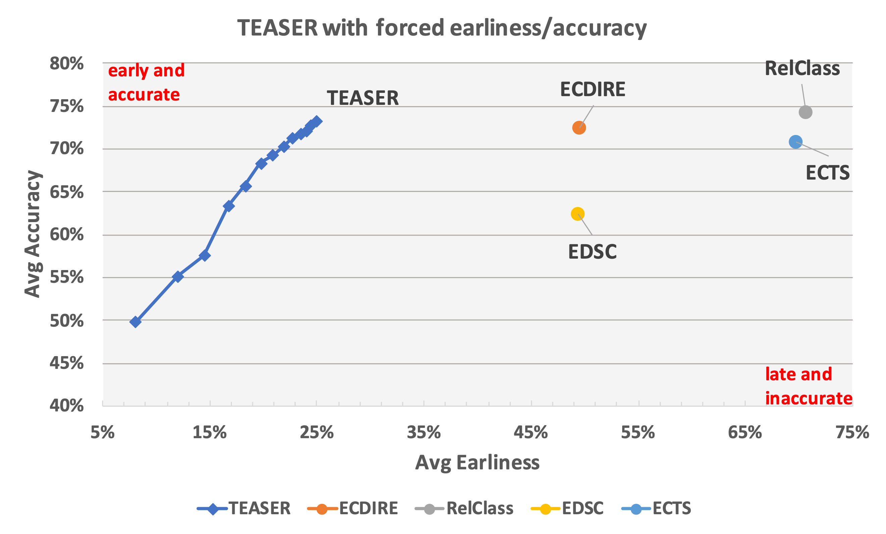
2-3 - times earlier
with same accuracy
On 45 UCR datasets: TEASER requires 2-3 times less data to make equally accurate predictions than state of the art
On average only first 23% of time series data required
Notes:
Overall Teaser is 2-3 times earlier than equally accurate approaches.
On average it requires only 23% of the time series to make correct predictions

Slide 7
TEASER: Early and Accurate Time Series Classification
Patrick Schäfer, Ulf Leser
Humboldt-Universität zu Berlin, Germany
Corresponding author: patrick.schaefer@hu-berlin.de
Journal Track at ECML / PKDD 2020, Belgium, 14.9.-18.9.
Notes:
My Name is Patrick Schäfer, I am working at the HU Berlin. I am presenting our framework for early and accurate time series classification called TEASER

Slide 8
Time series (TS) result from recording data over time
Increasingly popular due to growing importance of automatic sensors producing an increasing flood of large, high-resolution TS
It is assumed that all data is present at the time of classification
Often classification decisions are time-critical (e.g. prevent damage, diagnosis, predictive maintenance, reduce costs)
Early classification uses as few measurements as possible to make a safe (correct!) prediction
Safe prediction from here on?
Energy Consumption Trace
Notes:
Time Series result from recording data over time
Time Series data became increasingly popular due to the omnipresence of sensor’s recording large amounts of data
It is always assumed that we have all data present when doing classification
However, often classifications are time critical, e.g. to prevent damage to a machine, do medical diagnosis and determine the number of tests or to reduce the costs or loss in case of a stock market. Early classification tries to fill this gap, by producing a reliable / safe prediction seeing as few measurements as possible.
In case of energy consumption trace we ask, whether we have seen enough data to make a correct prediction.

Slide 9
Goal: Classify a time series early with high accuracy
We treat the safety (early but accurate) of a prediction as a classification problem
Correct/Safe prediction from here on?
Energy Consumption Trace
Notes:
Our goal is to classify a time series early and with high accuracy.
E.g. from an energy consumption trace results the question if the prediction is safe from this prefix on
We treat the safety of a prediction as a classification problem

Slide 10
First Tier: Slaves
i-th Time Series Snapshot
Confidences
i-th Slave Classifier
time series classifier
Input: fixed length snapshots
Output: class confidences (certainty of a prediction)
Notes:
TEASER models eTSC as a two-tier classification problem
On a first tier we have slaves.
There are time series classifiers that get as input fixed length snapshots
and output class confidences

Slide 11

Confidences
prediction: Microwave?
slave classifier1
Snapshot 1
Trace of energy consumption of a digital receiver
Notes:
The input signal is divided into snapshots
here we see the energy consumption of a digital receiver
A slave classifier periodically assesses the input snapshots and computes class probabilities.
It outputs microwave

Slide 12
Confidences
Confidences
prediction: RECEIVER?
1st slave classifier
2nd slave classifier
Snapshot 2
Trace of energy consumption of a digital receiver
Notes:
On the next snapshot it outputs
receiver

Slide 13
prediction: y=Microwave
prediction: y=Receiver
prediction: y=Receiver
Slave classifiers make predictions on snapshots and produce confidences
When are these safe?
Confidences
Confidences
Confidences
1st slave classifier
2nd slave classifier
3rd slave classifier
Snapshot 1
Snapshot 2
Snapshot 3
Energy Consumption Trace
Notes:
On the third snapshot it outputs
receiver
The question arises: after seeing how much data are these predictions safe?

Slide 14
Second Tier: Masters
i-th Slave’s Confidences
i-th Master Classifier
y=0, if unsafe
y=1, if safe
binary classification problem
Input: Class confidences
Output: safe or unsafe prediction
Notes:
a master classifier takes the class probabilities of the slave as input
it computes a binary decision on whether to report these as final result to postpone (when unsafe) or to continue (when safe) with the observation
a master accepts a prediction whenever it is confident of the slaves prediction

Slide 15
y=Unsafe
y=Safe
y=Safe
1st master classifier
2nd master classifier
3rd master classifier
Master classifiers
learn from historic data, if slaves seeing this much data we correct
decide if a slave’s prediction is safe/unsafe
Confidences
Confidences
Confidences
1st slave classifier
2nd slave classifier
3rd slave classifier
Snapshot 1
Snapshot 2
Snapshot 3
Energy Consumption Trace
Notes:
A master is always paired to a slave for a corresponding snapshot length
The Master learns from historic (training) data, if the slave’s predictions at these snapshot lengths were correct

Slide 16
y=Unsafe
y=Safe
y=Safe
Second Tier
Binary classification problem: Safe/Unsafe
Trained on class confidences as features
1st master classifier
2nd master classifier
3rd master classifier
Confidences
Confidences
Confidences
First Tier
Time series classification problem
Trained on time series snapshots
1st slave classifier
2nd slave classifier
3rd slave classifier
Energy Consumption Trace
S Snapshots
Notes:
We model eTSC as a two-tier classification problem
The first tier consists of a series of time series classifiers
The second tier consist of a series of binary classifiers with confidences as input and classes labels safe/unsafe, which is trained on historic data

Slide 17
y=Unsafe
y=Safe
y=Safe
Second Tier
Binary classification problem
1st master classifier
2nd master classifier
…
i-th master classifier
Confidences
Confidences
Confidences
…
First Tier
Time series classification problem
1st slave classifier
2nd slave classifier
…
i-th slave classifier
Safe Predictions:
Make predictions at fixed snapshot lengths (i.e. every 5%)
Hyperparameter v: Accept a prediction once v consecutive „Safe“ votes for the same class have been reached
Notes:
To increase the safety of predictions (and reduce overfitting), we will not stop after the first safe prediction but require a series of v consecutive safe predictions of the same class label

Slide 18
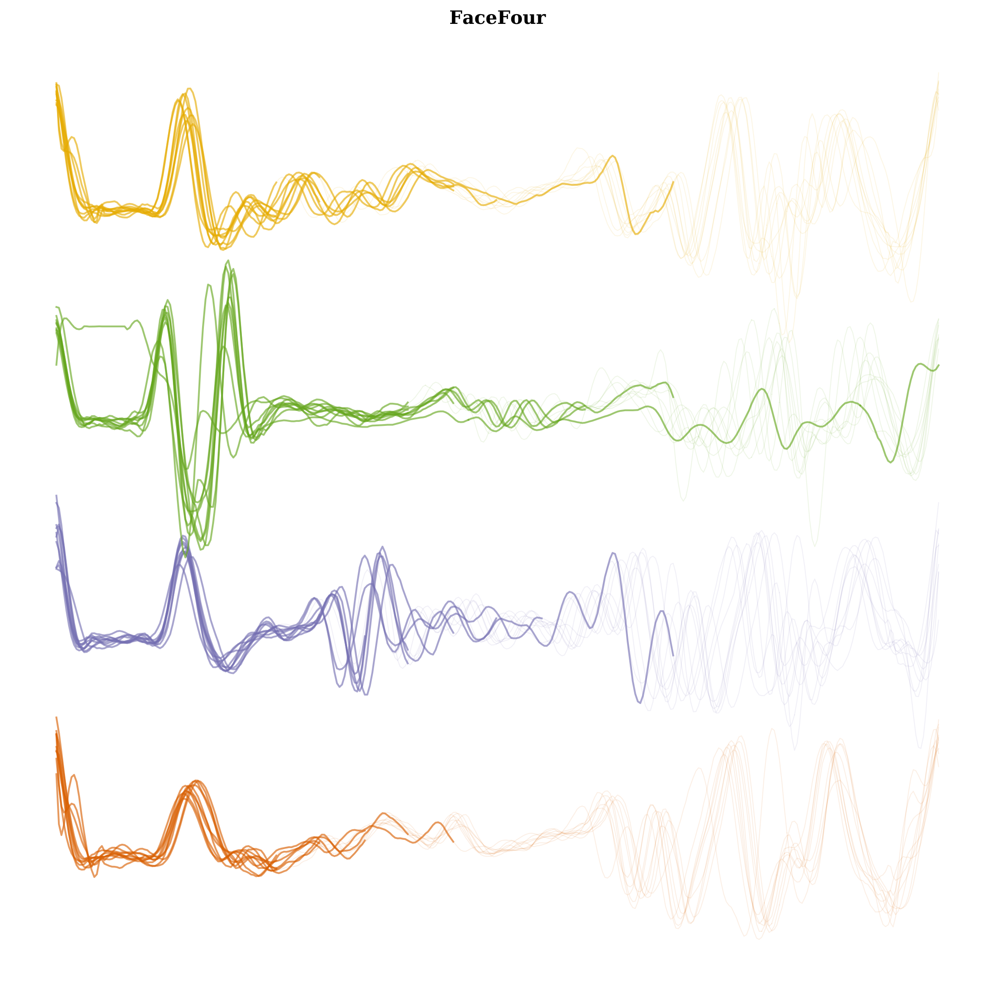
y=Safe / Unsafe
Training Slaves:
Hyperparameter S: Train S pairs of master/slave classifiers at increasing snapshot lengths Si
For every Si =100/S% time stamps:
Truncate all time series after Si
Train slave using snapshot length Si
i-th master classifier
Confidences
i-th slave classifier
class 1
class 2
si
class 3
Truncated and z-normed
training snapshots
class 4
Notes:
For training, the slaves divide the time series into S snapshots, e.g. each one has 5%
We truncate all time series after the snapshot length and train a time series classifier
It outputs class probabilities

Slide 19
y=Safe / Unsafe
Training masters:
For each snapshot Si: if the slave predicts a snapshot correctly, we label it by „y=safe“, otherwise „y=unsafe“
Train masters on this labelled data
To learn safe predictions, masters needs to be trained with a sufficient number of correct and false predictions
i-th master classifier
Confidences
i-th slave classifier
class 1
class 2
si
class 3
Truncated and z-normed
training snapshots
class 4
Notes:
The slaves predictions are labelled with safe and unsafe.
The masters is trained on the slave’s probabilities and these class labels safe and unsafe.
It learns to detect safe/unsafe slaves
To make safe/unsafe predictions, the master needs sufficient data for training.

Slide 20
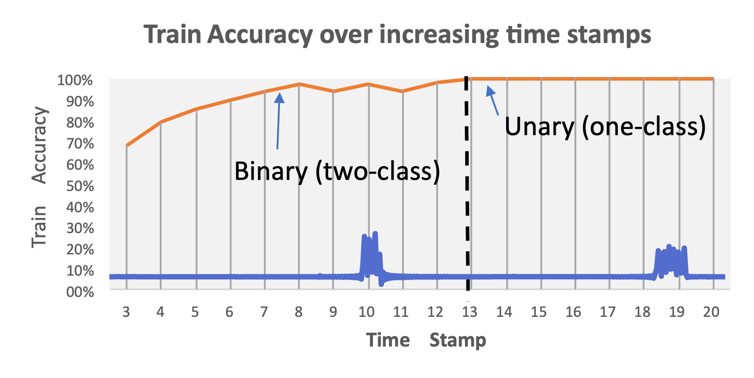
y=Safe / Unsafe
Training masters:
Devil in Detail: The more accurate a slave becomes, the less false predictions we see
Eventually: one-class classification
i-th master classifier
Confidences
i-th slave classifier
class 1
class 2
si
class 3
i-th Snapshot
Truncated and z-normed
training snapshots
class 4
Notes:
However, there is one devil in detail: the more accurate a slave becomes the less unsafe class samples we see.
When the slave reaches 100%, there is not a single unsafe example in the training data
Thus the problem eventually becomes a one-class classification problem, where we only see safe predictions in the train data

Slide 21
y=Safe / Unsafe
Training masters:
Devil in Detail: The more accurate a slave becomes, the less false predictions we see
Solution:
Slave: Time Series Classifier
Master: One-Class Classifier
i-th master classifier
Confidences
i-th slave classifier
class 1
class 2
si
class 3
Truncated and z-normed
training snapshots
class 4
Notes:
Our solutions is to model the master as a one-class classifier using only safe predictions.
The slave remains a time series classifier

Slide 22
Big Picture
Two-Tier Architecture:
S Slaves: Time Series Classifier
S Masters: One-Class Classifier
Hyperparameters: S and v
Training: S pairs of slaves/masters trained at increasing snapshot lengths
Prediction:
Slave: one classification after every snapshot length
Master: a prediction is safe after seeing v equal-class safe slave predictions
Notes:
The big picture:
We model eTSC as a two-tier classification problem
We split the data into S snapshots
a slave classifier periodically assesses the input time series and computes class probabilities.
the master classifier is a one-class classifier that takes the class probabilities of the slave as input
computes a decision on whether to report these as final result or continue with the observation
master takes a decisions whenever it has seen v consecutive safe predictions

Slide 23
Experiments
TEASER was evaluated on 45 UCR datasets (results published for 85 datasets)
Two metrics: accuracy and earliness
State-of-the-art competitors:
ECTS
ECDIRE
EDSC
RelClass
Notes:
We performed a series of experiments on the UCR datasets using accuracy and earliness.
The state-of-the-art competitors are ECTS, ECDIRE, EDSC, Relclass

Slide 24
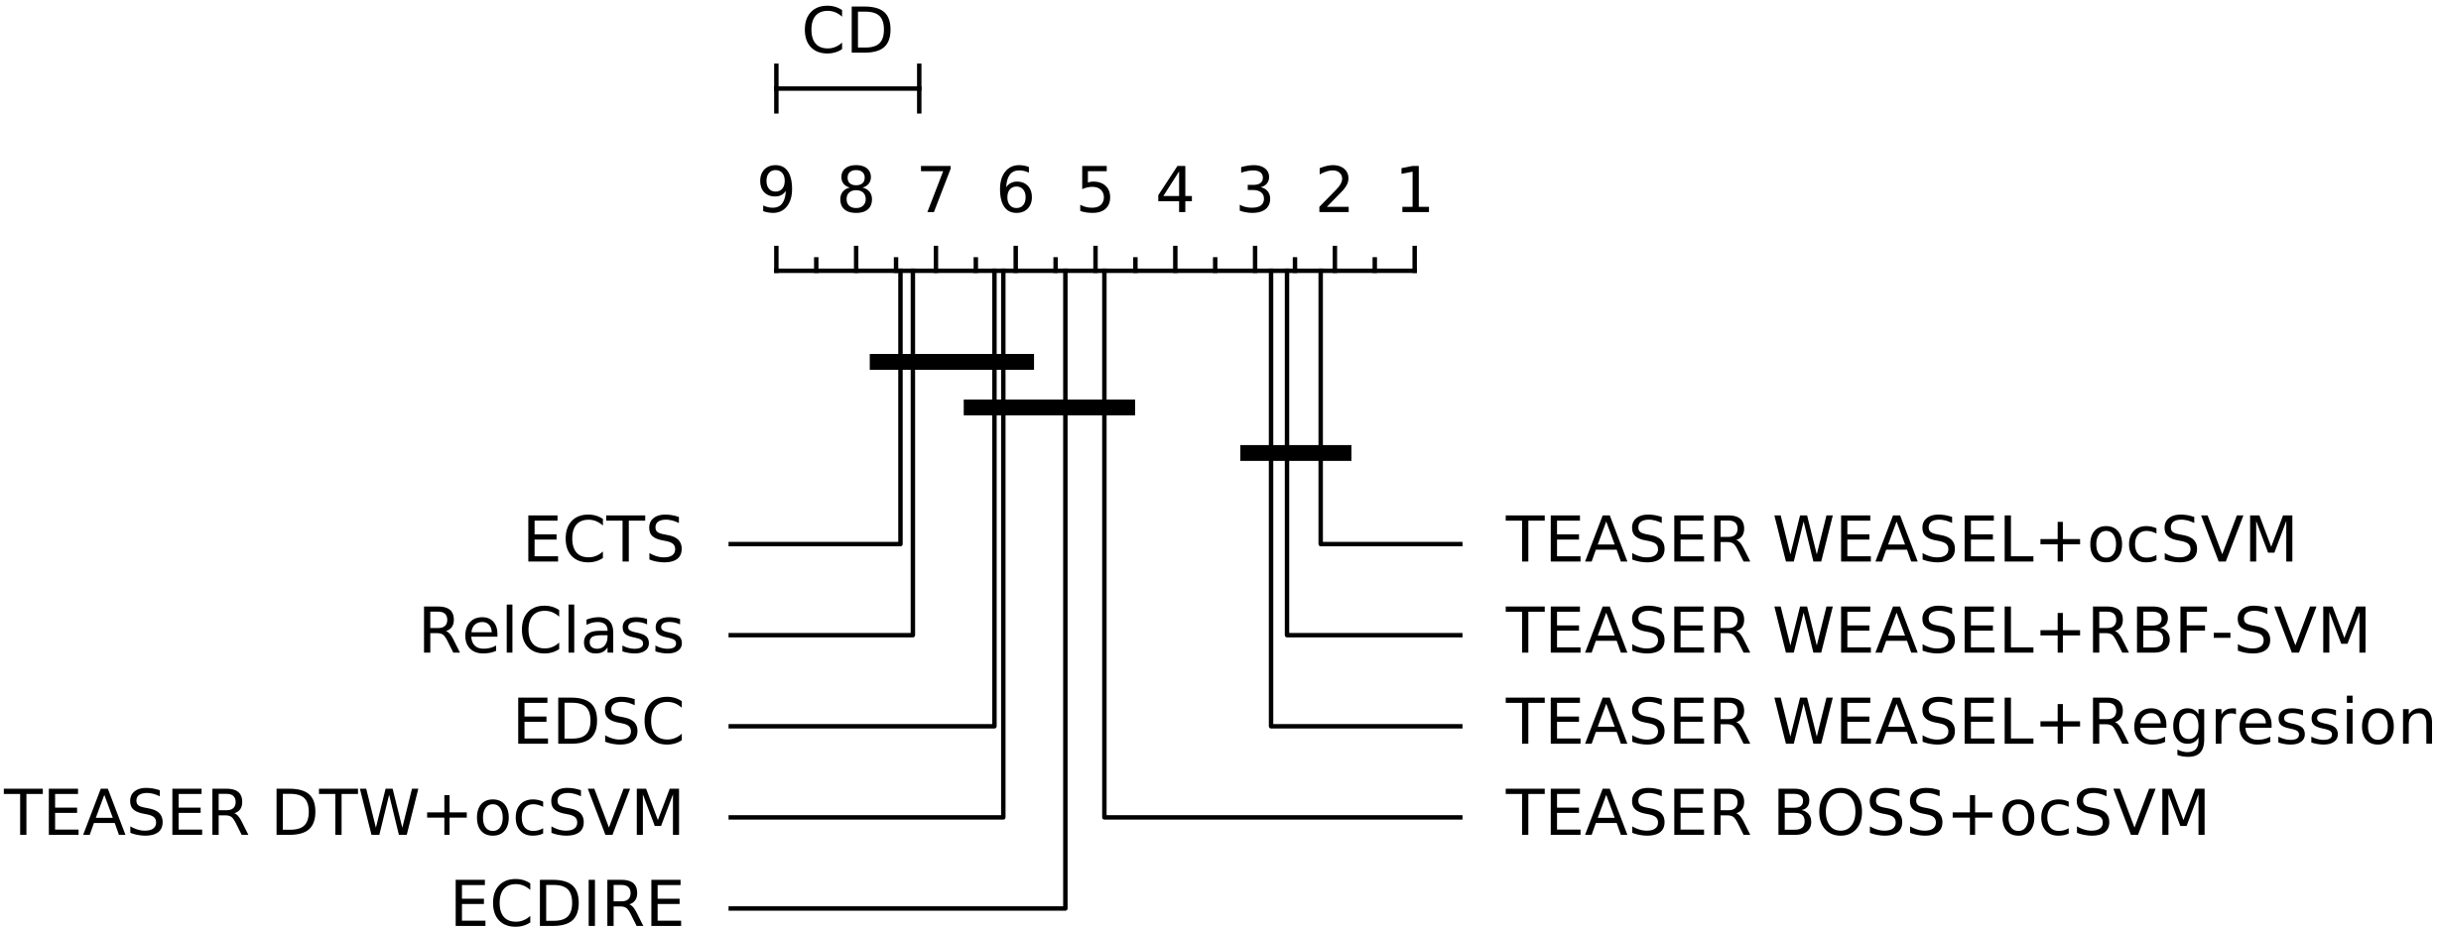
We performed a series of tests with different slave (time series) and master (one-class) classifiers
WEASEL as slave and one-class SVM as master performed best
Notes:
We tested different slave and master classifiers.
Overall WEASEL and one-class classification performed best, i.e. have the lowest average rank over the UCR datasets

Slide 25
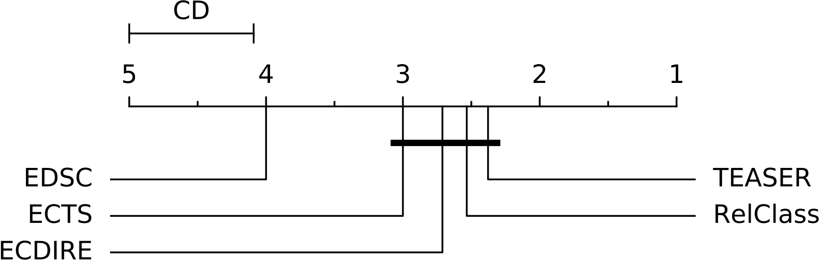
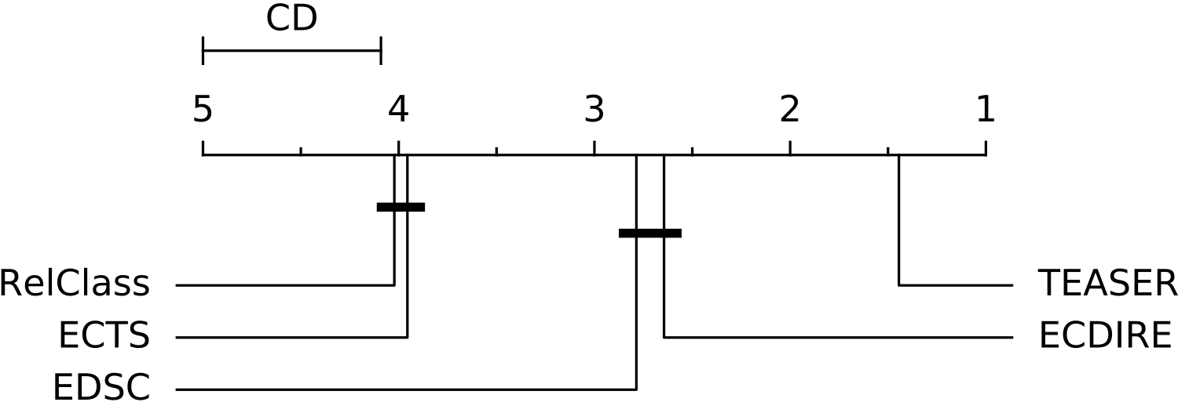
Accuracy
Earliness
TEASER requires 2-3 times less data to make equally accurate predictions
On average only the first 23% of time series data required
Notes:
Overall TEASER requires 2-3 times less data to make equally accurate predictions
And on average only the first 23% of the time series are inspected

Slide 26
2-3 - times earlier
with same accuracy
TEASER requires 2-3 times less data to make equally accurate predictions
On average only first 23% of time series data required
Notes:
This diagram underlines that TEASER is 2-3 times earlier than state of the art with the same accuracy.

Slide 27
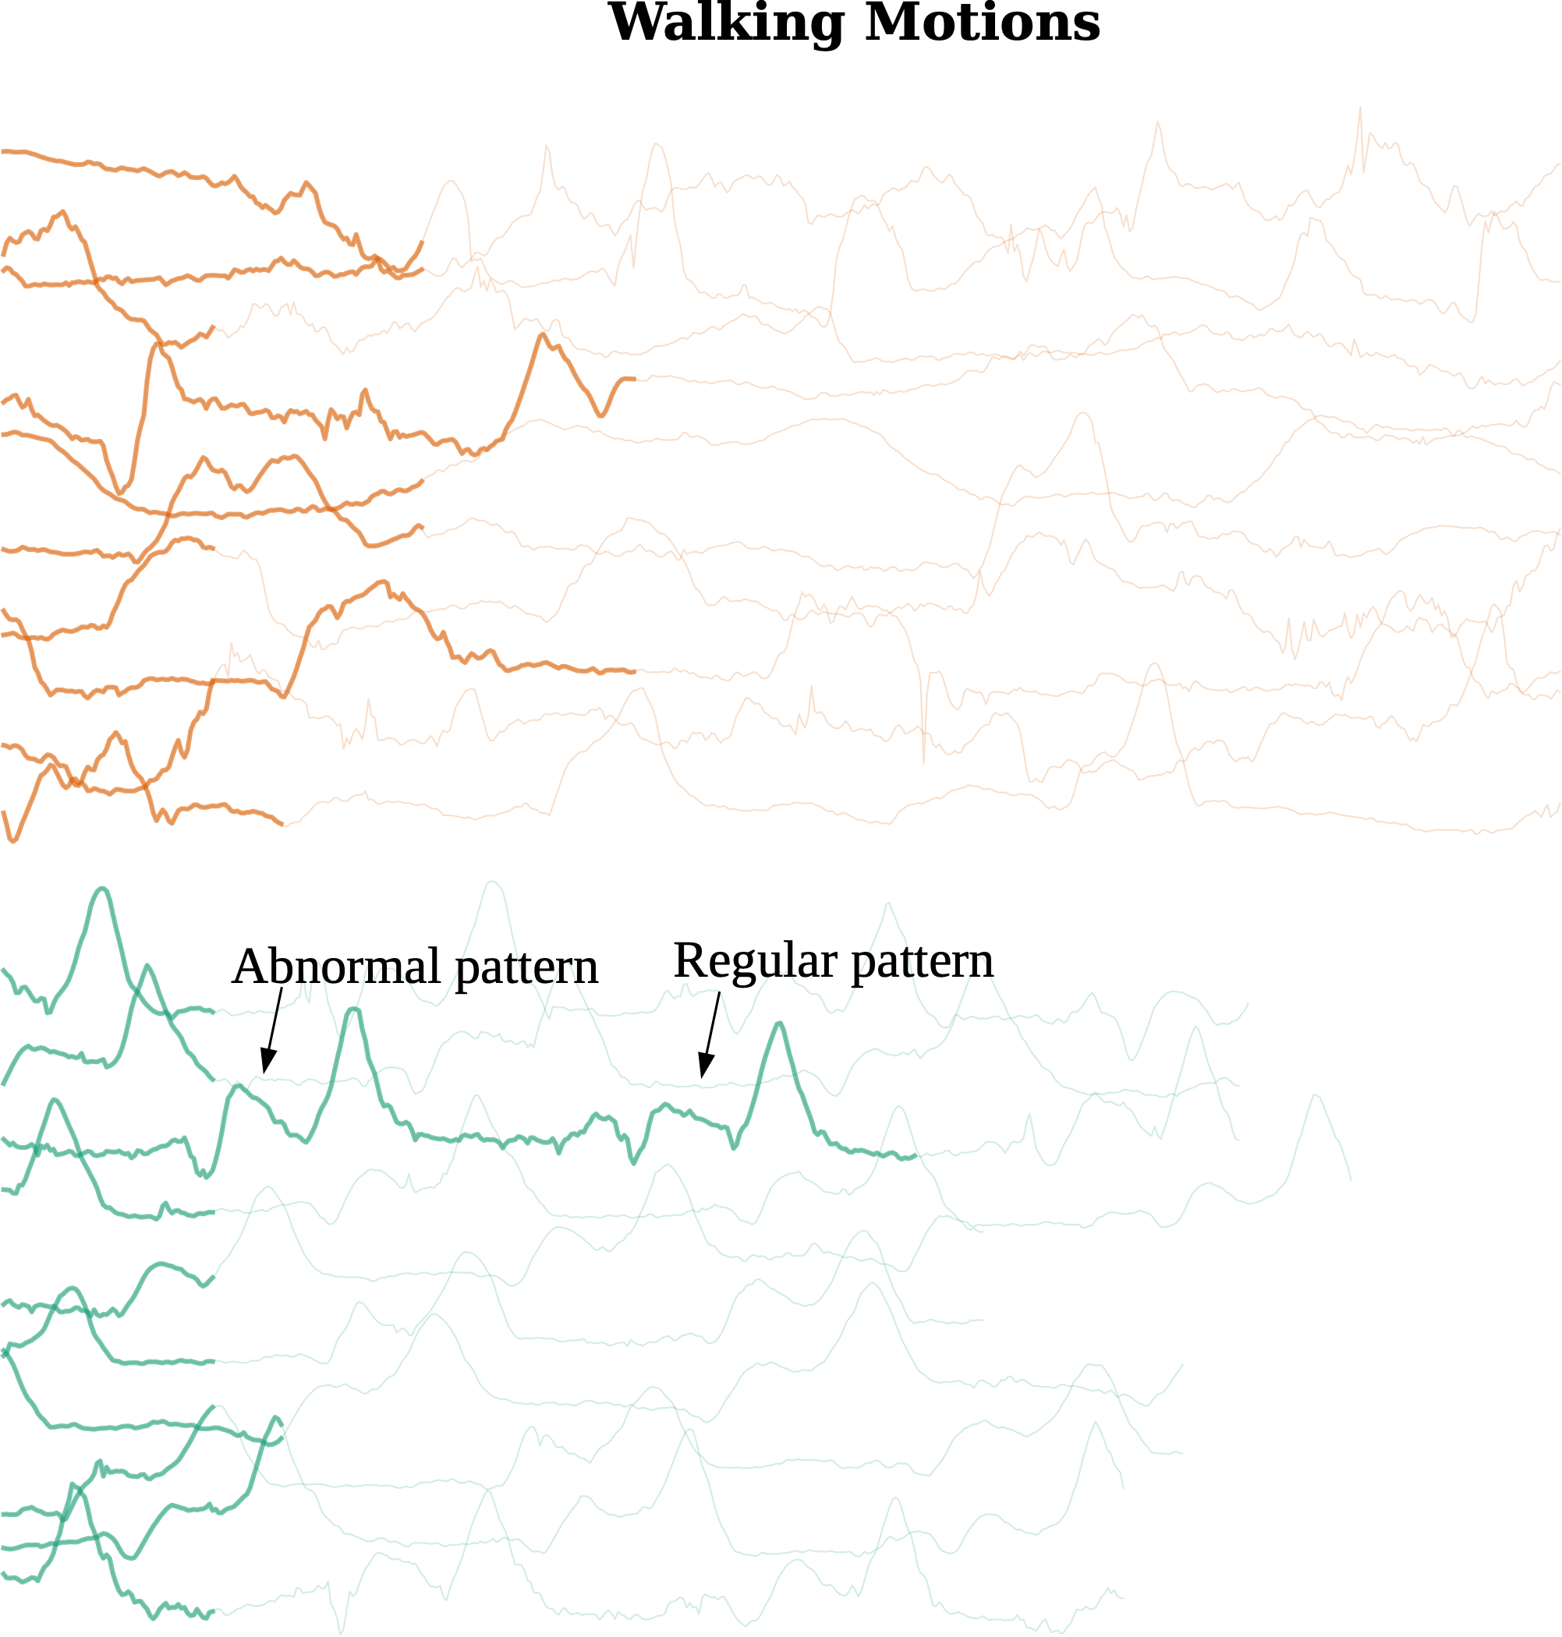
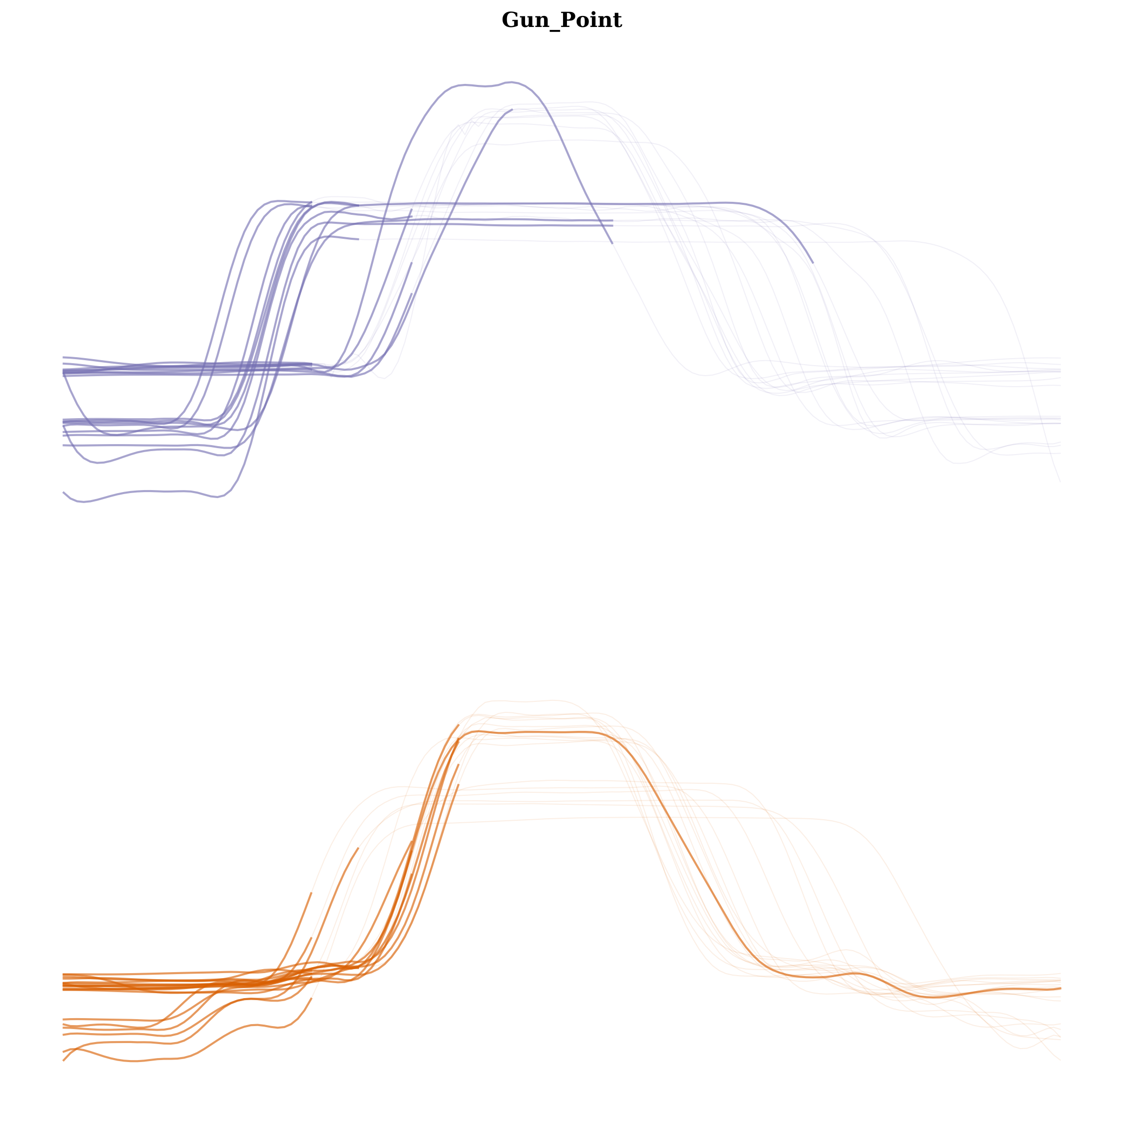
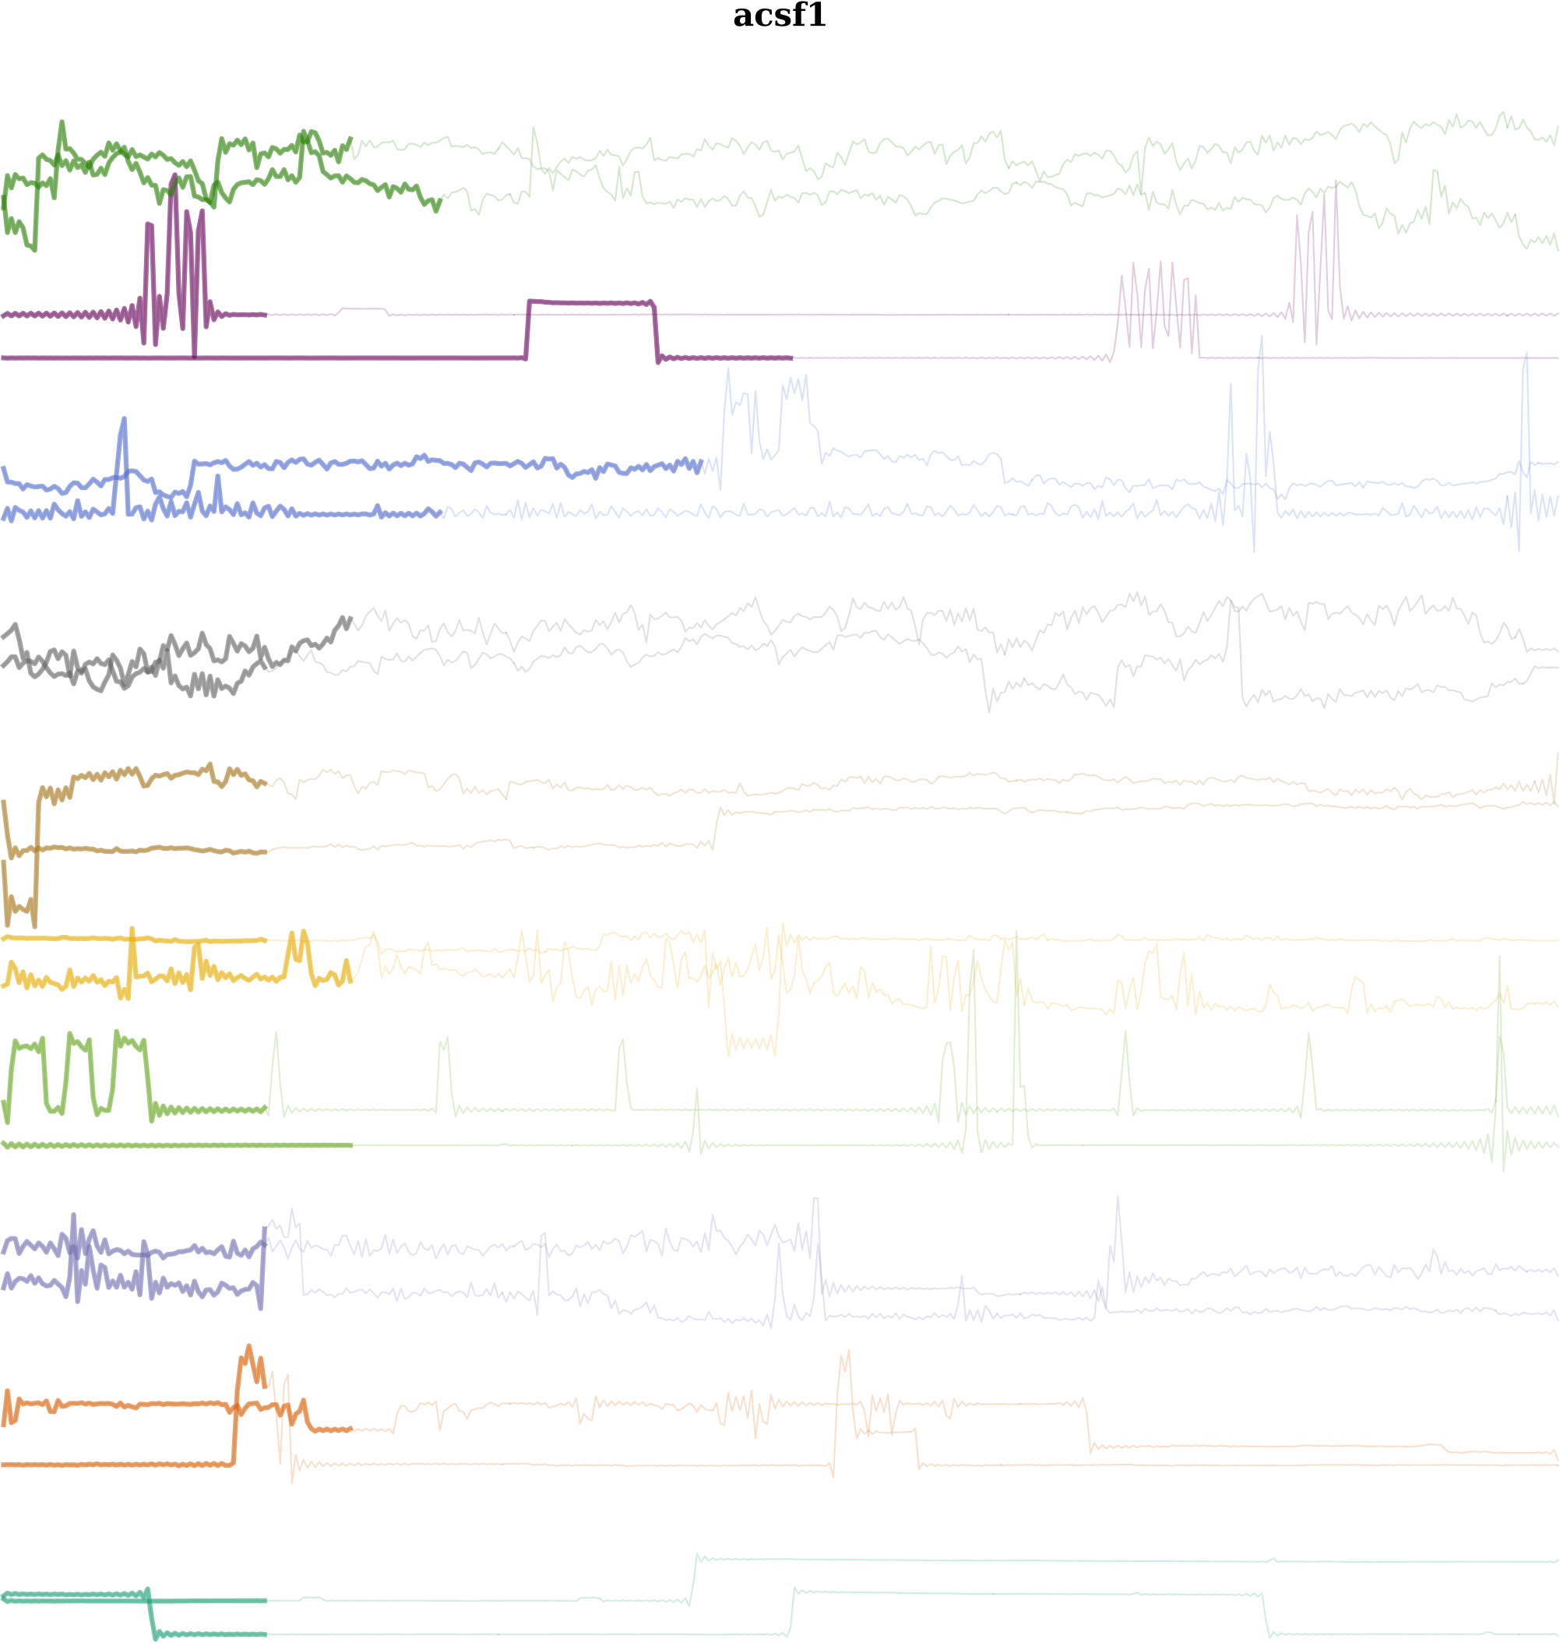
Some More Use-Cases
Energy consumption
Walking Motions
Gun-Point
Notes:
We also looked at some other use cases.

Slide 28
Summary
TEASER is a novel two-tier architecture for early classification of time series
The safety of a predictions is treated as a one-class classification problem
Slave classifiers periodically make predictions and give class confidences
Master classifiers continuously analyze the output of probabilistic slaves
TEASER outperforms all other methods by a large margin in terms of earliness on a competitive accuracy
Notes:
TASER is a novel two tier architecture for early classification
The safety of a predictions is treated as a one class classification problem
Where Master classifiers continuously analyze the output of probabilistic slave classifiers
Overall TEASER outperfomed all other methods by a large margin in terms of earliness and accuracy.

